Slide 1
Aramco Upstream Solutions Technathon 2019 AI Challenge 3: Lithofacies classification based on rock image recognition using deep learning
Sergey Safonov
Program Director
Aramco Innovations

Slide 2
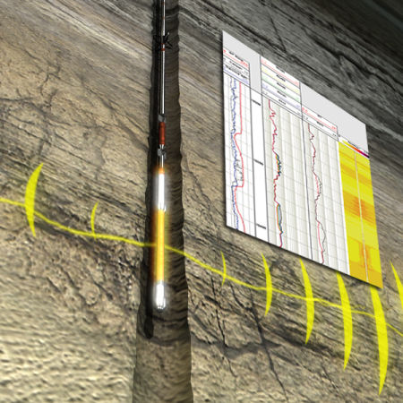
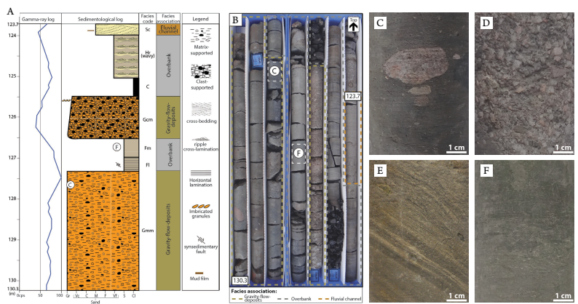
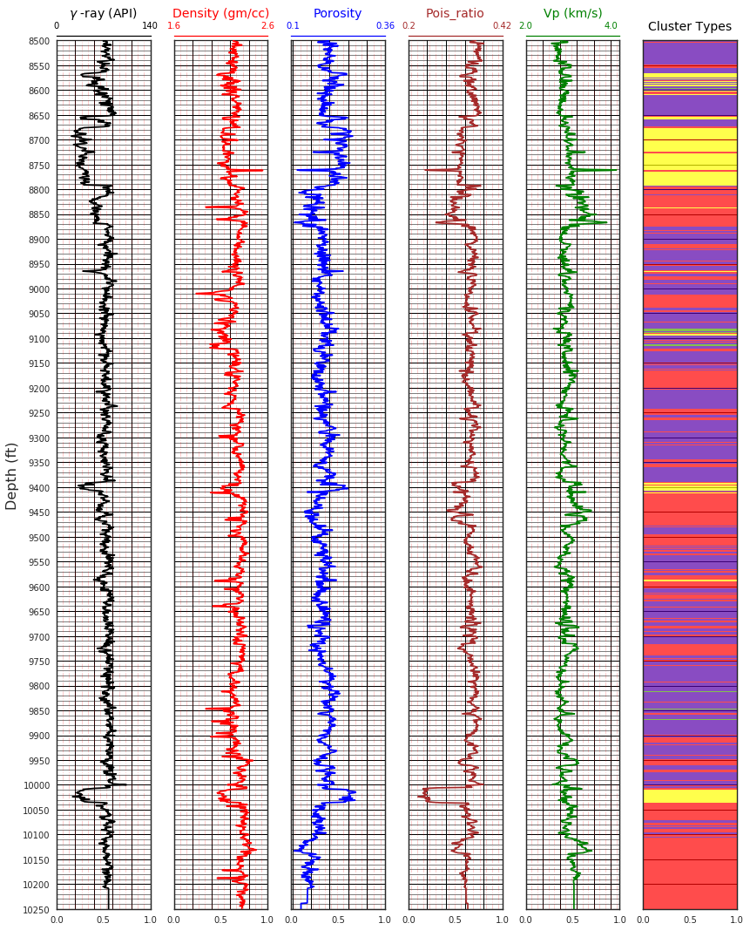
Prospecting for hydrocarbon presence: Reservoir characterization Physical measurements and visual rock analysis

Slide 3
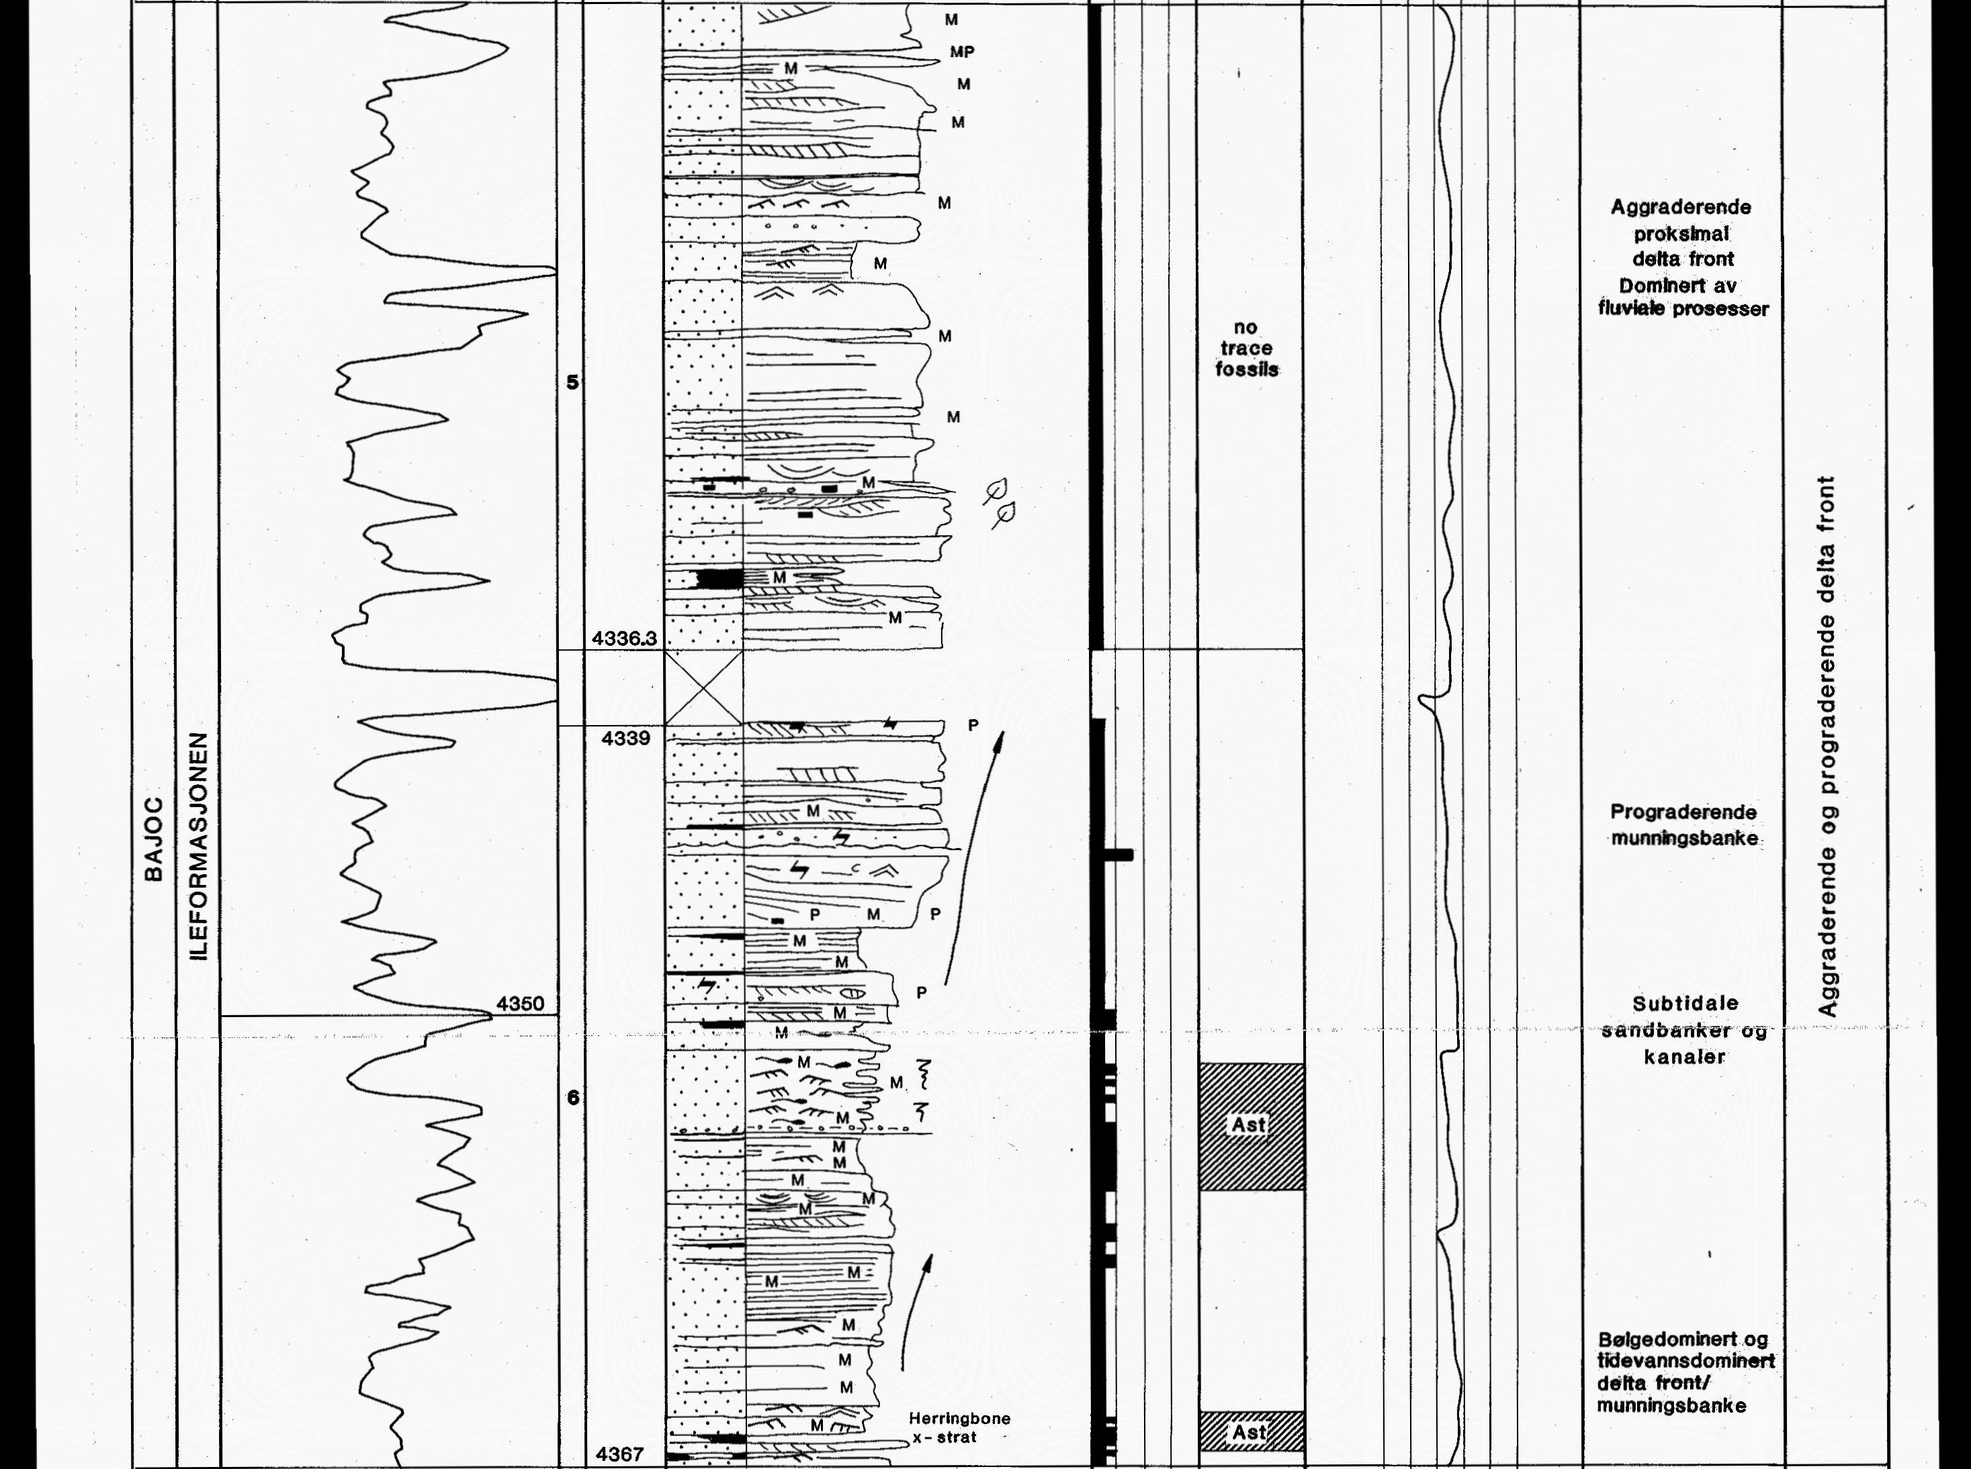
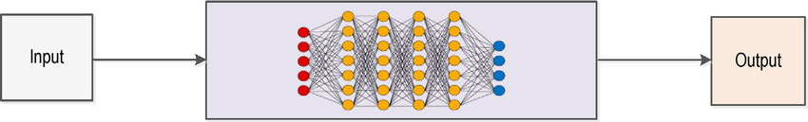
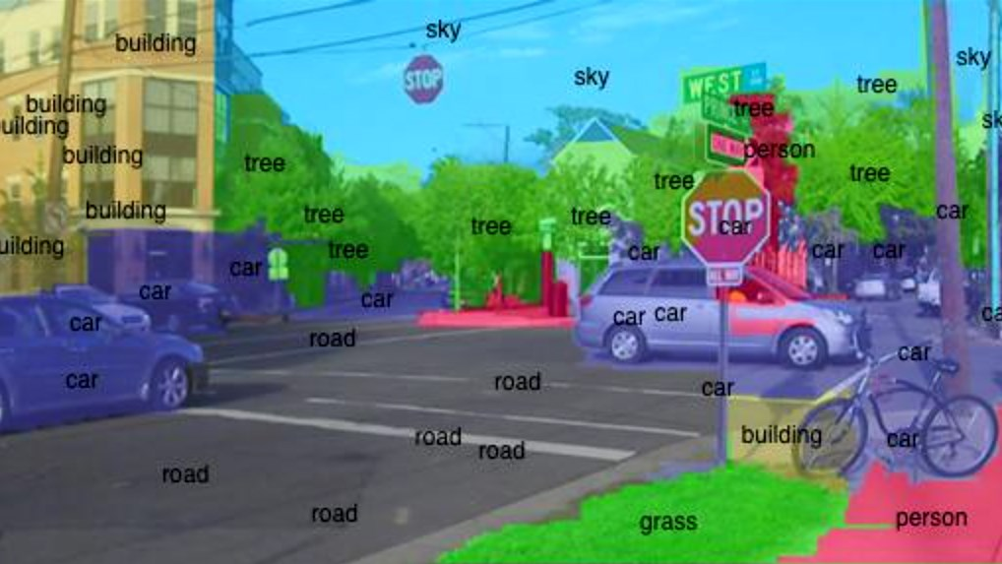
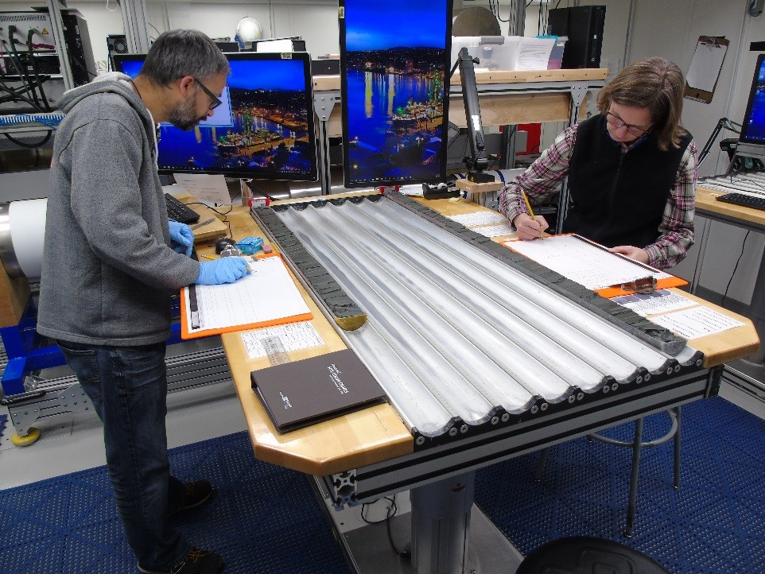
Visual core analysis: lithotype classification Manual work by a geologist vs Automated deep learning
Lithology log

Slide 4
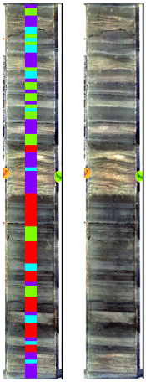
Automated rock lithotyping Linked well log and core image lithology classification
Depth correlation
Lithotype sequence
Well-log feature
recognition
Multivariant
Clustering
Image feature
recognition
Inclusions
Rock texture
Lamination
RBG color

Slide 5

Data
Photographs of rock samples (cores)
for all wells
Lithology logs in pdf and/or jpg for wells
for 6507/7/4, 6506/12/5 and 6406/3/2
Well logs
for all wells
Grain size information for wells
for 6507/7/4, 6506/12/5 and 6406/3/2
Lithostratigraphy table for general information
for all wells

Slide 6

Details of the challenge
Translate lithology logs from pdf or jpg to data readable format
Construct data science model for identifying multivariant features or clustering well log data
Train deep learning model to identify some features in core images per lithotypes
Build multivariant correlation between log and image features

Slide 7

Evaluation of the performance
Technical evaluation
CSV/excel files with depth regions of the linked lithological types obtained by joint well log and core image classification for Well X
A presentation with the solution
Core image recognition per the corresponding lithofacies
Well log feature clustering
Correlation model between log and image lithologic types
Bonus: Identification of uncertainty for the lithotype correlation

Slide 8


Subject matter experts
Leyla Ismailova Aramco Moscow Global Research Center
Email: Leyla.ismailova@aramcoinnovations.com
Sergey Safonov Aramco Moscow Global Research Center
Email: sergey.safonov@aramcoinnovations.com Phone: +7 906 054 1631

